Slide 1

Unit-01 Git & GitHub
Development Tools
DU #2605CS104
Prof. Samir Kariya
Computer Engineering Department
samir.kariya@darshan.ac.in
9427148490

Slide 2

Outline
Foundations & the local workflow
Mastering commits and undoing mistakes
Branching & Merging
GitHub & Remote collaborations
Advance Git:
rebase
reflog
Looping

Slide 3
Foundations & the local workflow
Looping
Section - 1

Slide 4



Story
I need a simple Student Management System.
Create a Project with following features:
Add student
Display student
Excellent!
After 10 Minutes...
Sorry... I forgot one feature.
Can you also add Search Student?"
You Think and say “No Problem”
Your software has
Add student
Display student
Search student

Slide 5
Story
After another 10 minutes ….
Actually... Display Student is not required anymore.“
"Instead, I want Update Student."
Ok. You have overwrite the old code and save the file.
Add student
Search student
Update student
After Lunch
“One more small change.“
Developers know that "small change" usually isn't small.
Your software has
Add student
Display student
Search student
Delete student
“Please add Delete Student."

Slide 6
Story
Next Morning…..
“I checked the software."
"I don't like the latest version."
"Can you please give me the version where there was Display Student, but Delete Student wasn't added yet?"
You open your folder.
There is only one file.
StudentManagement/
main.c
The old code has already been overwritten.
You start sweating. 😅

Slide 7
Story
"Can I recover that old version?“
Ctrl + Z?
Recycle Bin?
Undo?
Restore Previous Version?
“No. Once the file has been saved multiple times, the earlier versions are gone unless you kept separate copies."

Slide 8
Story
“What Beginners Usually Do”
Developers start creating files like:
main.c
main_new.c
main_latest.c
main_final.c
main_final2.c
main_final_last.c
main_final_last_really_final.c
‘Which file contains the version with Display Student?’

Slide 9
What is Version Control?
Version Control System (VCS) is a tool that records changes to files over time.
Benefits:
Tracks changes
Maintains history
Supports collaboration
Allows rollback to previous versions
Prevents accidental data loss
Example:
Version 1 → Version 2 → Version 3 → Version 4

Slide 10
Problems Without Version Control
Traditional Approach
Project Files:
Project_Final.docx
Project_Final_v2.docx
Project_Final_v2_Final.docx
Project_Final_v2_Final_Updated.docx
Challenges:
Confusion
Duplicate files
Difficult rollback
No change history

Slide 11
What is Git?
Traditional Approach
Git is a distributed version control system created by Linus Torvalds in 2005.
Features:
Fast and lightweight
Distributed architecture
Tracks file changes
Supports branching and merging
Widely used in DevOps and software development

Slide 12
Why Git is Important?
Advantages:
Change tracking
Collaboration support
Backup of project history
Easy rollback
Branching and experimentation
Industry standard tool

Slide 13
Git Architecture
Working Directory
Staging Area
Local Repository
Components
Working Directory
Staging Area (Index)
Local Repository (.git)

Slide 14
Git Local Workflow
Create/Edit File
git add
Staging Area
git commit
Local Repository
Workflow Steps
Create or modify files
Stage changes
Commit changes
View history

Slide 15
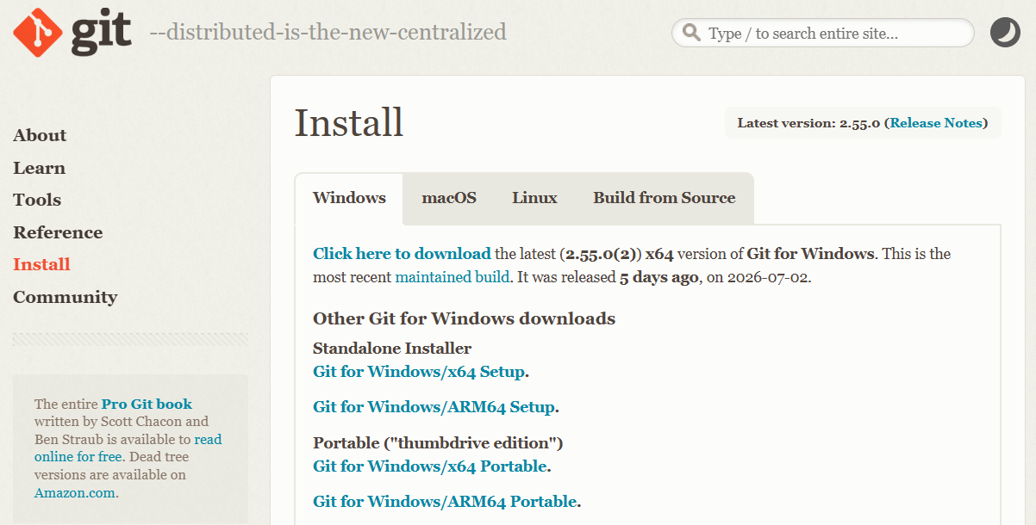
Installing Git
https://git-scm.com/install/windows
Verify Installation
git --version
git version 2.55.0

Slide 16
Initial Git Configuration
Initial Git Configuration
Configure Username
git config --global user.name “Samir Kariya”
Configure Email
git config --global user.email “samirkariya@gmail.com”
Verify Configuration
git config --list

Slide 17
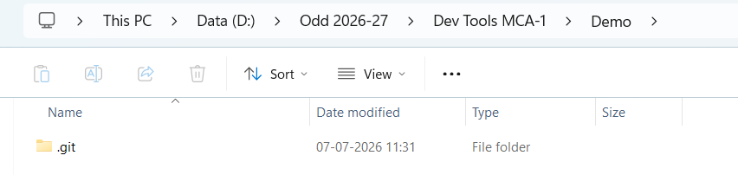
Creating a Git Repository
Create Project Folder
Initialize Git
git init
Git creates:
.git /
Contains:
Commit history
Branch information
Configuration
Metadata

Slide 18
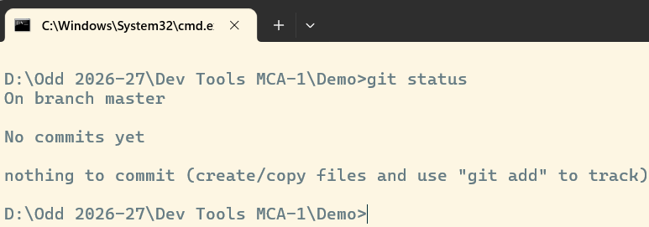
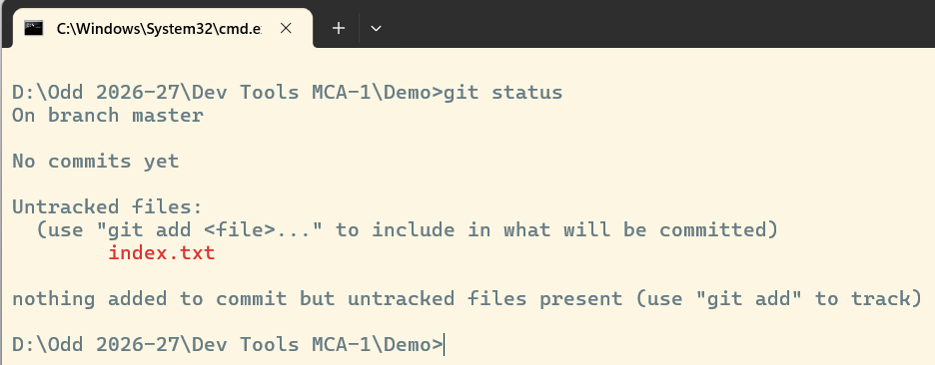
Creating a Git Repository
Checking Repository Status
git status
//purpose to show
modified files
staged files
untracked files
Creating First File
index.txt
Check status
git status

Slide 19
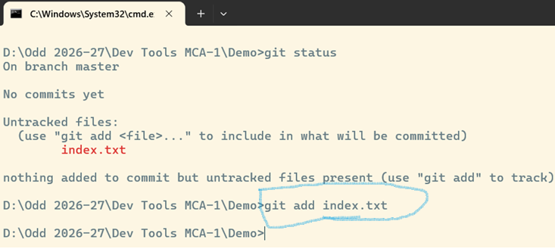
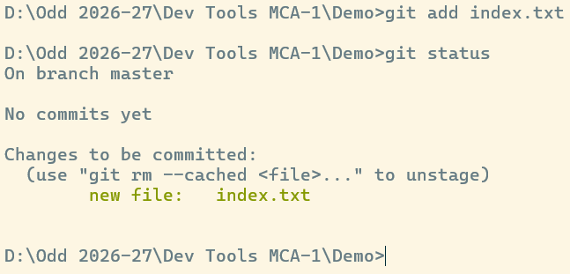
Creating a Git Repository
Staging Changes
Add single file
git add index.txt
Add all files
git add .
After Staging, Checking Repository Status
git status
//purpose:
Moves files from Working Directory to Staging Area.

Slide 20
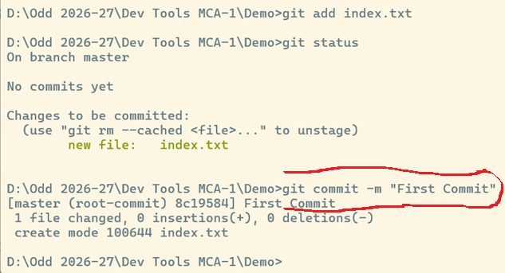
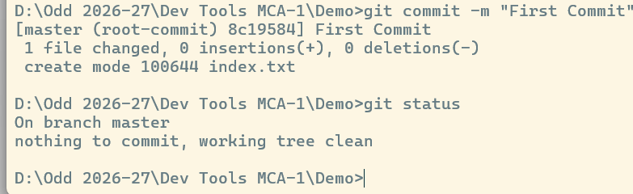
Creating First Commit
Commit Changes
git commit -m "Initial commit"
After Commit, Checking Repository Status
git status
//purpose:
Saves a snapshot of the project.
//Best Practice:
Use meaningful commit messages.

Slide 21
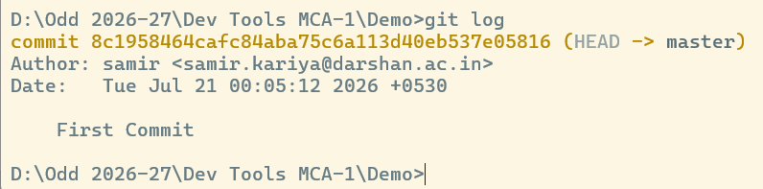
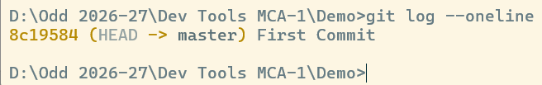
Viewing Commit History
Tracking
git log
Shows:
Commit ID (Hash)
Author
Date
Message
Simplified log view
git log --oneline

Slide 22
Understanding File States in Git
Untracked
git add
Staged
git commit
Commited
Important Git States
Untracked
Modified
Staged
Committed

Slide 23
Common Git Commands Summary
Command Purpose
git init Initialize repository
git status Check status
git add file Stage file
git add . Stage all files
git commit –m Save snapshot
git log View history
git log --oneline Short history
git config --list View configuration

Slide 24
Mastering commits and undoing mistakes
Looping
Section - 2

Slide 25
What is a Commit?
A commit is a saved snapshot of the project at a specific point in time.
Project state 1
COMMIT 1
Project state 2
COMMIT 2
Project state 3
COMMIT 3
Important:
A commit records:
What changed
Who made the change
When it was made
A unique commit ID
Commit = Save Point of Your Project

Slide 26
Commit Messages
Bad Commit Messages ❌
update
changes
done
final
new
Fix
Good Commit Messages ✅
Added student registration form
Fixed login validation error
Updated database connection
Added even number calculation
A commit message should clearly explain what was changed.

Slide 27
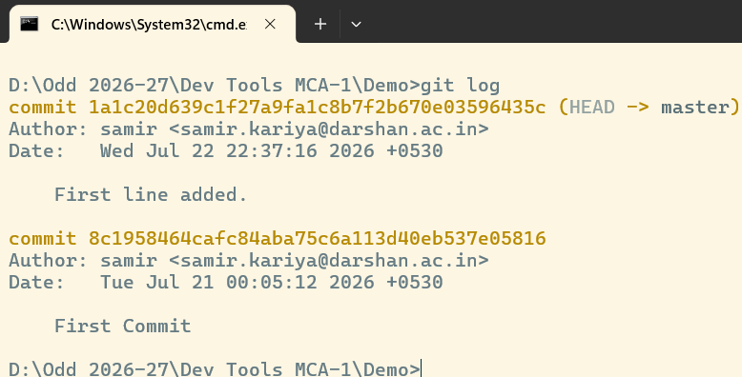
Commit
Viewing Commit History
git log
Information Displayed
Commit ID
Author
Date
Commit message
Short Commit History
git log --oneline

Slide 28
Commit
View a Specific Commit
git show <commit-id>
Shows:
Commit details
Author
Date
Files changed
Actual code changes

Slide 29
VIEWING CHANGES
Why Compare Changes?
Before committing, developers should ask:
What exactly did I change?
git diff
Shows changes made in the Working Directory that have not yet been staged.
git diff –staged
Shows changes that are already in the Staging Area
Edit File
↓
git diff
↓
Review Changes
↓
git add
↓
git diff --staged
↓
Review Again
↓
git commit

Slide 30
UNDOING MISTAKES
Everyone Makes Mistakes
Before undoing anything, ask:
Where is the mistake?
1. Working Directory?
↓
2. Staging Area?
↓
3. Local Repository?
↓
4. Remote Repository?
You write code
↓
You modify code
↓
You make a mistake
↓
You want to go back

Slide 31
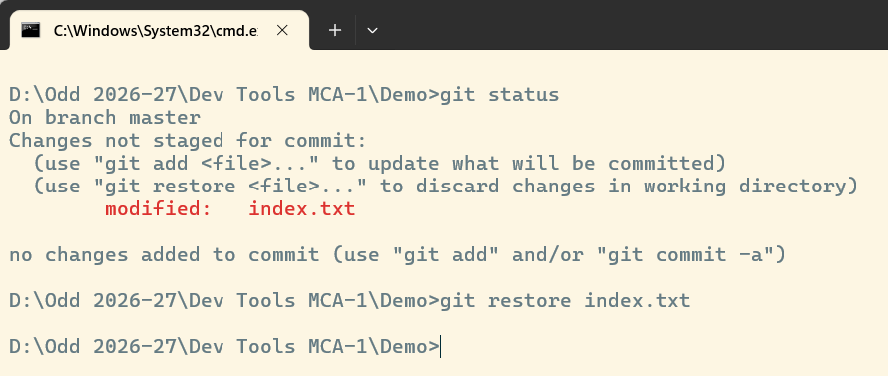
UNDOING MISTAKES
1) Undo Changes in Working Directory
Situation:
You modified a file but have not staged it.
Command:
git restore filename
Result:
The file returns to the last committed version.
File modified
↓
git status
↓
I don't want this change!

Slide 32
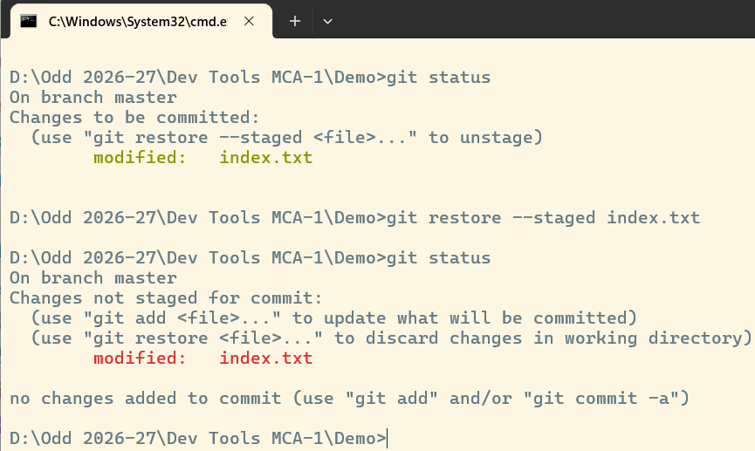
UNDOING MISTAKES
2) Undo Changes in Staging Area
Situation:
You executed:
git add index.txt
But now you decide:
I do not want to commit this file yet.
Command:
git restore --staged app.c
Result:
The file is in working directory.
The file content is not deleted.

Slide 33
FIXING COMMIT MISTAKES
3) Mistake in the Latest Commit
Situation:
Suppose you created:
git commit -m "Added login"
But immediately realize:
You forgot one file
The commit message is incorrect
You need to add a small change
Solution:
git commit --amend --no-edit
Result:
The previous commit is updated.
Example:
First Commit
git commit -m "Added login“
Forgot a File
git add validation.c
Add it to the Previous Commit
git commit --amend –no-edit

Slide 34
FIXING COMMIT MISTAKES
3) Mistake in the Latest Commit
Change the Last Commit Message
git commit --amend -m "Added login validation“
Before:
Added login
After:
Added login validation
Note:
Use --amend carefully when the commit has already been shared with others.

Slide 35
UNDOING COMMITTED CHANGES
Undoing a Commit
Suppose the history is:
Commit 1: Initial Project
↓
Commit 2: Add Calculator
↓
Commit 3: Add Bug ❌
You want to undo the change introduced by Commit 3.
Command:
git revert <commit-id>
Git creates a new commit that reverses the changes of the previous commit.
Commit 1
↓
Commit 2
↓
Commit 3 ❌
↓
Commit 4
(Reverses Commit 3)

Slide 36
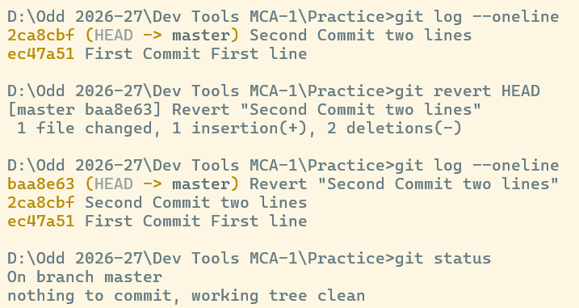
UNDOING COMMITTED CHANGES
Why is git revert Safe?
Original History:
A → B → C
After Revert:
A → B → C → C-Revert
History is preserved
No commit is deleted
Safe for shared repositories

Slide 37
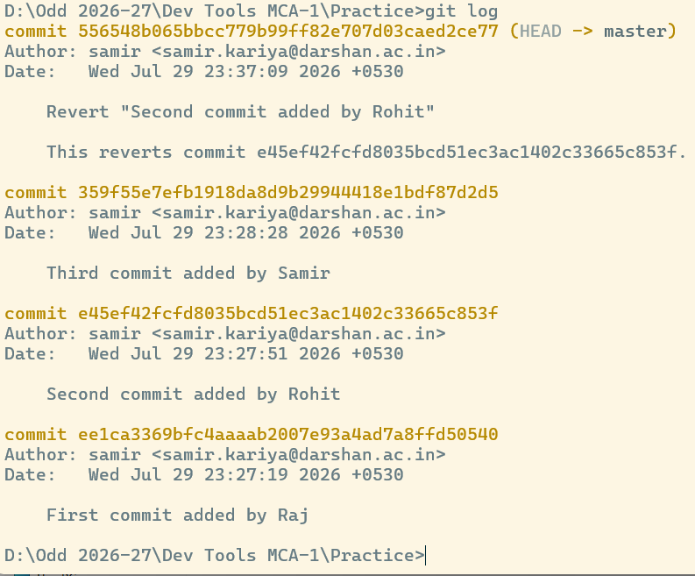
UNDOING COMMITTED CHANGES
Reverting an Older Commit That Causes Conflict
Original History:
A → B → C
After Revert:
A → B → C → B-Revert
git log --oneline
git revert <older-commit-id>
Edit file manually and make changes as per your requirement
git add <filename>
git revert --continue

Slide 38
UNDOING COMMITTED CHANGES
RESET
git reset moves the current branch to an earlier commit.
Original History:
A → B → C → D
After reset:
A → B
The branch moves backward.
Types of git reset
Soft Reset
Mixed Reset
Hard Reset

Slide 39
UNDOING COMMITTED CHANGES
RESET
Types of git reset
Soft Reset
git reset --soft HEAD~1
Removes the last commit
Keeps changes staged
Mixed Reset
git reset HEAD~1
Removes the last commit
Keeps file changes
Unstages the changes
Hard Reset
git reset --hard HEAD~1
Removes the last commit
Removes file changes
Potential data loss!

Slide 40
UNDOING COMMITTED CHANGES
git revert VS git reset
Feature | git revert | git reset
Creates new commit | Yes | No
Preserves history | Yes | Can rewrite history
Safe for shared repository | Yes | Usually No
Useful for public commits | Yes | Avoid
Removes commit from branch history | No | Yes

Slide 41
UNDOING COMMITTED CHANGES
Git Undo Decision Tree
Did you modify a file?
│
▼
Do you want to discard it?
│
Yes
│
▼
git restore file
Did you stage a file?
│
▼
Want to unstage it?
│
▼
git restore --staged file
Did you commit a mistake?
│
▼
Shared with others?
│ │
Yes No
│ │
git revert git reset

Slide 42
Branching and Merging
Looping
Section - 3

Slide 43
Introduction to Branch
Imagine four students are working on the same project.
Student A Login Module
Student B Registration Module
Student C Payment Module
Student D Bug Fixes
Question:
Should everyone edit the same file directly?
Answer: No.
Everyone works in their own branch.
Later all work is merged into the main project.
What is a Branch?
A branch is An independent line of development.
Its like -
A copy of your project
Where you can experiment safely
Without affecting the main project

Slide 44
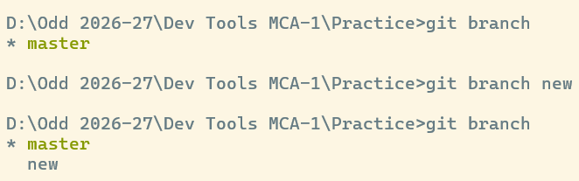
Introduction to Branch
Branch Commands
Creating a new branch git branch <branch-name>
List branches git branch
* indicates current branch.
Switch branch git switch <branch-name>
Create and Switch together git switch -c <branch-name>
Merge branch git merge <branch-name>
The current branch receives the merge.
Delete branch git branch –d <branch-name>
View graph git log --graph --all

Slide 45
Demo - Branch and Merge
Step 1
Create a project folder
git init
Create file – index.txt, write content
Student Management System
git add index.txt
git commit –m “Initial Project”
Step 2
Create Login Branch git branch login
Switch into login git switch login
Modify the index.txt,
Student Management System
Login Module
git add index.txt
git commit –m “Added Login Module”

Slide 46
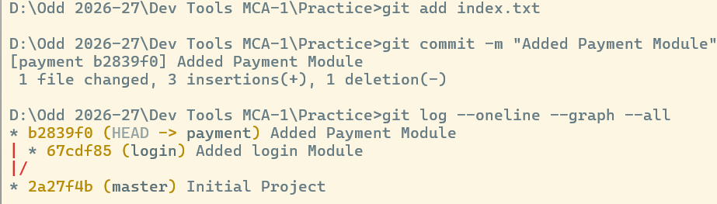
Demo - Branch and Merge
Step 3
Switch into master branch
Check the file content
Step 4
Create & Switch Payment Branch git switch –c payment
Modify the index.txt,
Student Management System
Payment Module
git add index.txt
git commit –m “Added Login Module”
Step 5 - View Graph
git log --oneline --graph --all

Slide 47
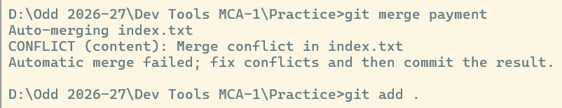
Demo - Branch and Merge
Step 6 - Merge Login Branch
Switch into master branch git switch master
Merge git merge login
Project After Merge – Check File content
Student Management System
Login Module
Step 7 – Merge Payment Branch
Merge git merge paymemt
Result
CONFLICT

Slide 48
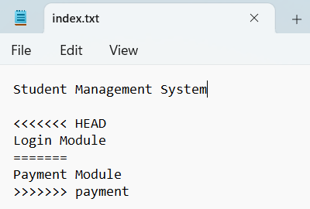
What is Merge Conflict?
Occurs when Two branches modify the same line or nearby lines
Git cannot decide.
Developer must choose.
Resolve Conflict
Final File
Student Management System
Login Module
Payment Module
Conflict Example
Save
git add
git commit
Merge Completed.

Slide 49
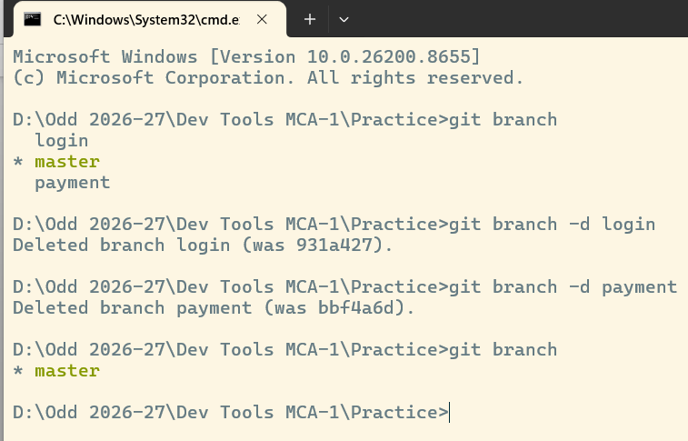
Delete Branch
After successful merge
git branch -d login
git branch -d payment

Slide 50
Github & remote collaborations
Looping
Section - 4

Slide 51
What is GitHub?
GitHub is a cloud-based platform that hosts Git repositories.
It provides:
Remote storage
Team collaboration
Version history
Pull Requests
Issue Tracking
Project Management
CI/CD Integration
Git = Version Control
GitHub = Cloud Platform for Git Repositories

Slide 52
Why GitHub?
Without GitHub
Code remains on one computer
Difficult to collaborate
No online backup
Sharing is difficult
With GitHub
Access from anywhere
Team collaboration
Secure backup
Easy code sharing
Open Source contribution
Git | GitHub
Version Control System | Cloud Hosting Platform
Works locally | Works online
Tracks file changes | Stores Git repositories
Command Line Tool | Web Interface
No Internet required | Internet required
Local Repository | Remote Repository
Stored on your computer | Stored on GitHub
Fast operations | Accessible by team members
Private to your machine | Used for collaboration

Slide 53
GitHub Workflow
Create GitHub Repository
Create Repository
↓
Clone Repository
↓
Write Code
↓
git add
↓
git commit
↓
git push
↓
GitHub Updated
Steps
Login GitHub
Click New Repository
Enter repository name
Select Public or Private
Create Repository

Slide 54
Important Terminology
Repository (Repo)
A repository is a storage location that contains the project files and complete Git history.
Local Repository
Stored on your computer.
Remote Repository
Stored on GitHub.
Owner
The person who created the repository.
Collaborator
A person who has permission to contribute to the repository.
Public Repository
Anyone can: View code, Clone repository, Download project
Suitable for Open-source projects, Student portfolios.

Slide 55
Important Terminology
Private Repository
Only authorized users can access the project.
Suitable for Company projects, Client work, Confidential code
README.md
When someone opens your project,
How will they know: What is the project? How to install it? Technologies used ? Features?
.gitignore
License
A License specifies how others may use your code.
GitHub Dashboard

Slide 56
Connecting Local Git with GitHub
What is Remote Repository?
A Remote Repository is an online version of a Git repository stored on a server such as GitHub.
What is Origin?
When we connect GitHub for the first time:
git remote add origin URL
origin is simply a nickname
Verify Remote
git remote -v
Output:
origin https://github.com/student/demo.git (fetch) → download
origin https://github.com/student/demo.git (push) → upload
First Push
git push -u origin main
Second Push
git push

Slide 57
Connecting Local Git with GitHub
Authentication
PAT (Personal Access Token)
GitHub: Settings → Developer Settings → Personal Access Tokens → Generate New Token → Permissions: ✔ repo
Copy token safely
SSH Key
SSH allows secure communication.
ssh-keygen -t ed25519 -C "user_email@gmail.com“
SSH setup is usually done once per computer.
Clone // download + history
git clone URL
Push // upload
git push
Pull // download + merge
git pull
Fetch //download only
git fetch
HTTPS | SSH
Uses PAT | Uses Key
Easy | Professional
Beginner Friendly | Better Long-Term
May ask authentication | Usually password-free

Slide 58
Common Commands
git remote add origin URL
git remote -v
git branch -M main
git push -u origin main
git push
git clone URL
git pull
git fetch

Slide 59
Demo
GitHub Remote Repository Integration.
Create repository on GitHub.
Connect local repository.
Push code.
Verify repository online
GitHub Collaboration Workflow.
Create branch feature-profile.
Add profile page.
Push branch to GitHub.
Create Pull Request.
Merge Pull Request.
Pull latest changes to local repository.

Slide 60
Advance git: rebase & reflog
Looping
Section - 5

Slide 61
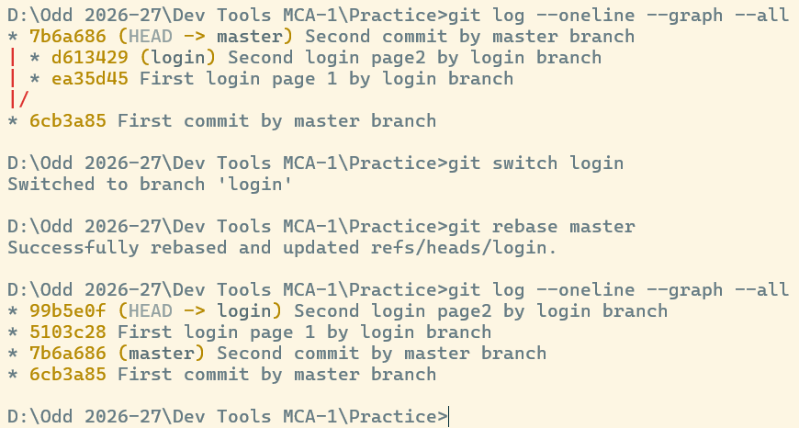
Advance git: rebase
Git Rebase – Rewrite commit history and create a cleaner project history
Steps: (In local Repo)
In master/main branch, create one file index.txt , add, commit A – First commit
Create login branch, In login branch, create login.txt file, add, commit B - First commit login branch
In login branch, create navbar.txt file, add, commit C – Second commit login branch
Switch to master branch, create another file home.txt , add, commit D – Second commit
(login branch does not aware about commit D)
Switch to login branch,
Apply the command
git rebase master
Git creates new versions of B and C.
Therefore, Commit IDs change.
Rebase rewrites history.

Slide 62
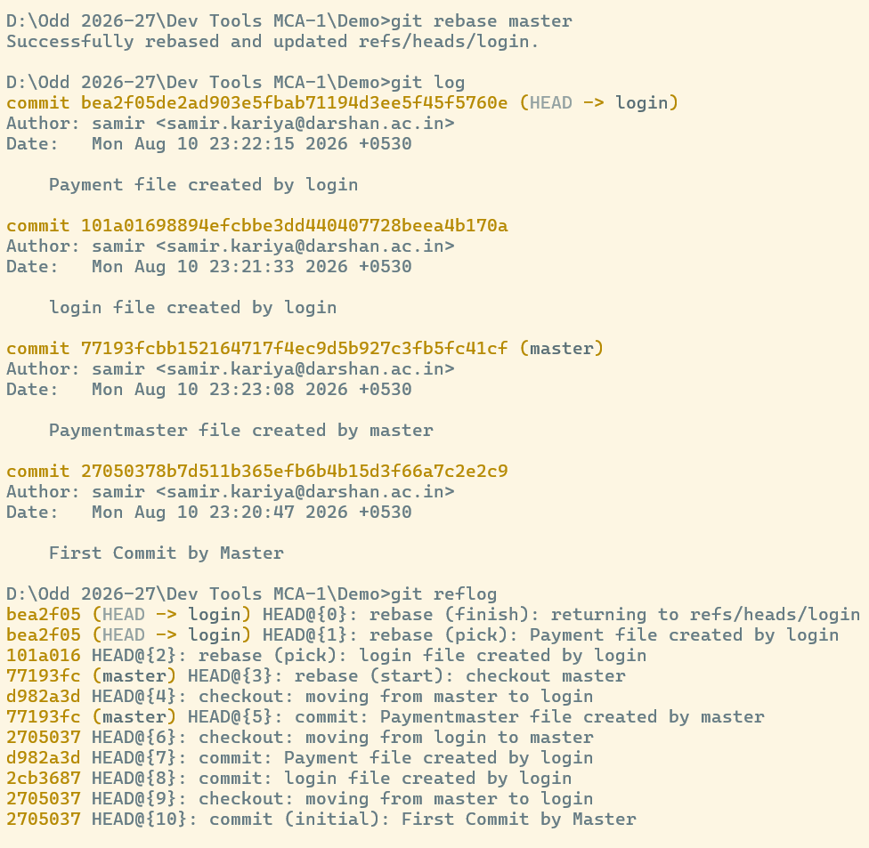
Advance git: reflog
Git Reflog
git log only shows commits in the current history.
But... What if history changes? Git stores another log Called Reflog.
Command:
git reflog
What Can Reflog Recover?
Lost commits
After reset
After rebase
Deleted branches (if commits are still referenced)
Mistaken checkout
Accidental hard reset

Slide 63
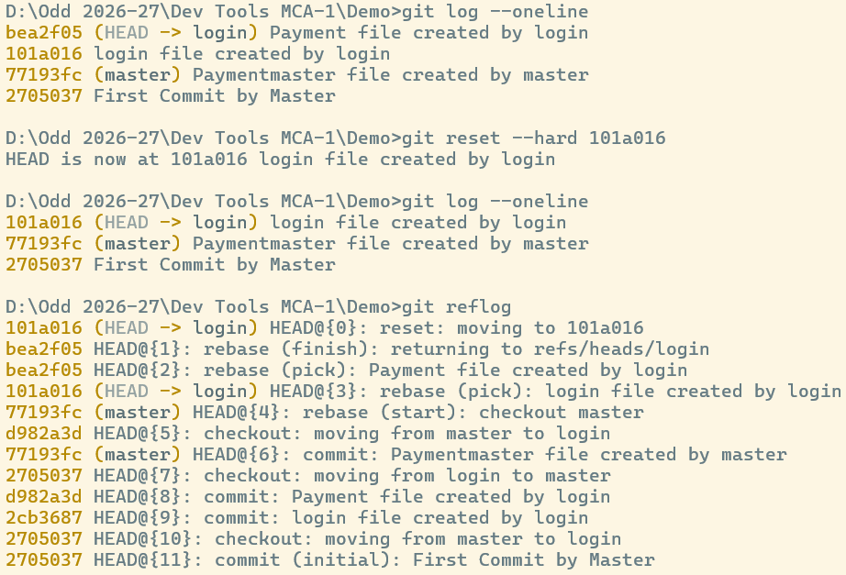
Advance git: reflog
Git Reflog
What Can Reflog Recover?
Lost commits
After reset
After rebase
Deleted branches (if commits are still referenced)
Mistaken checkout
Accidental hard reset

Slide 64
Advance git: reflog
git log | git reflog
Shows commit history | Shows HEAD movement history
Only reachable commits | Includes commits that may no longer be in the visible history
Shared with everyone when pushed | Local to your repository only
Used for viewing project history | Used for recovery and troubleshooting

Slide 65
Devlopment Tools(DT)
DU #2605CS104
Prof. Samir Kariya
Computer Engineering Department
Samir.kariya@darshan.ac.in
9427148490

